Slide 1

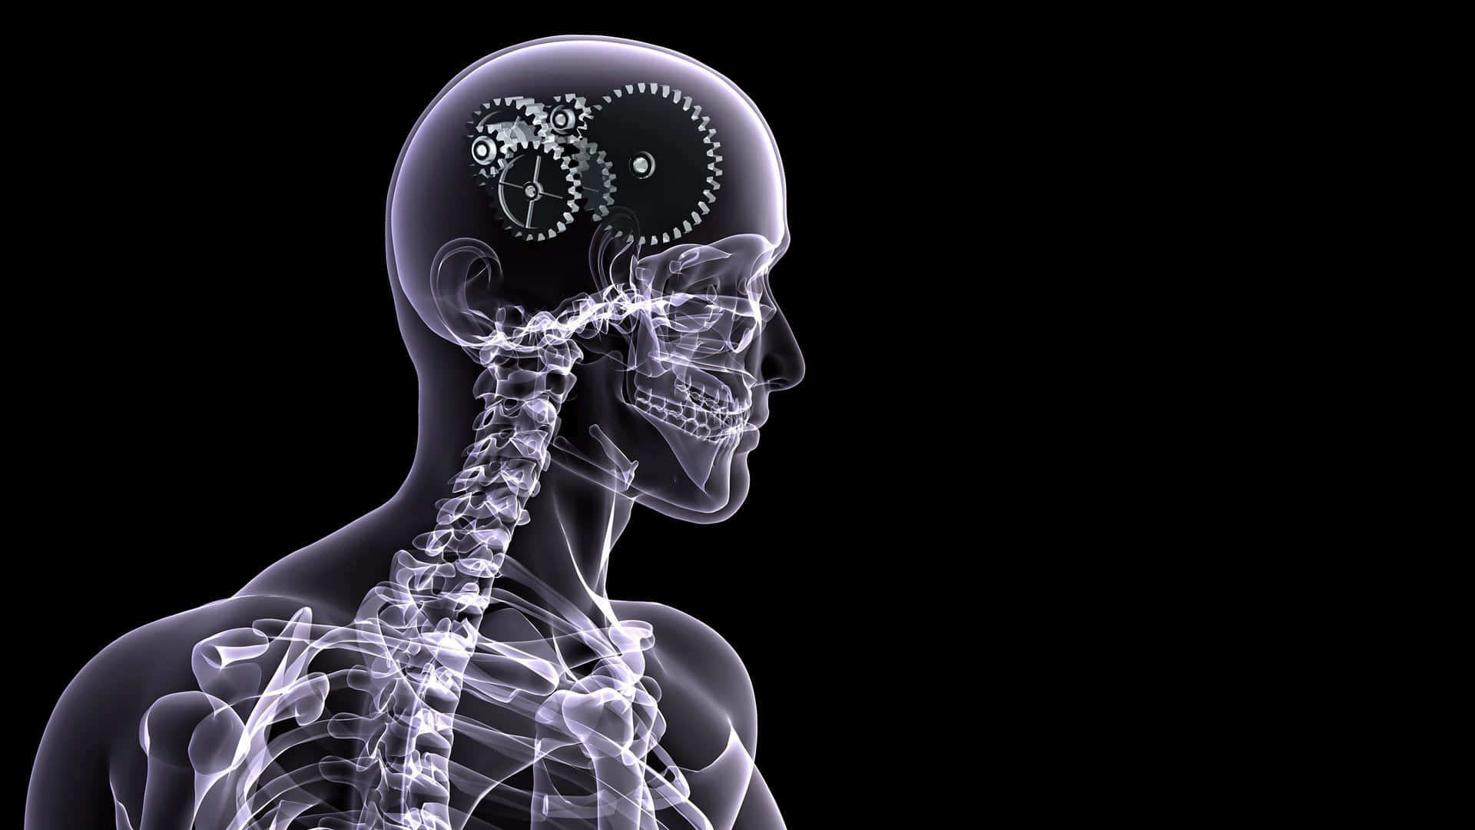

DEEP LEARNING
PROJECT
BONE X-RAY ANALYSIS
Section - 25 Batch - 1

Slide 2
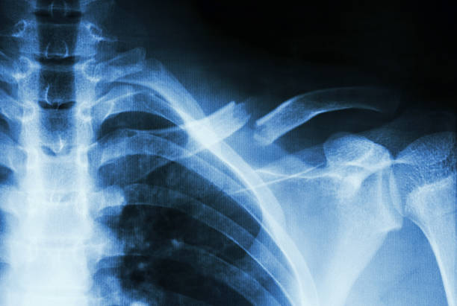
Team Details:
2100090066 - Rasagna Devi. K
2100039129 - Deekshitha. D
2100032283 - Venkata Pavan Nikhil. D
2100030724 - Mukesh Reddy G

Slide 3


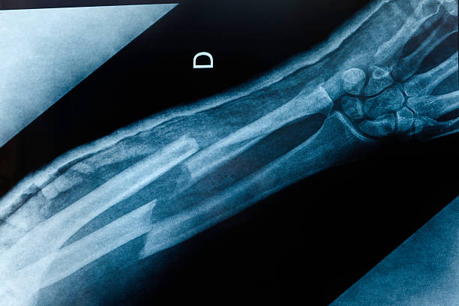
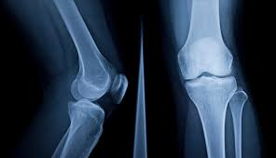
Introduction
Bone fractures are prevalent injuries that necessitate precise and prompt diagnosis for successful treatment. X-ray imaging serves as a commonly employed modality for identifying bone fractures owing to its accessibility and cost-effectiveness. Nonetheless, accurately interpreting x-ray images can pose challenges, demanding expertise and time from healthcare professionals. In this project, our objective is to develop a deep learning model for automating bone x-ray analysis. The primary aim is to aid healthcare professionals in efficiently diagnosing fractures, thereby improving patient care outcomes.

Slide 4
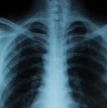
SIGNIFICANCE OF THE PROBLEM
Bone fractures are a significant public health concern globally, accounting for a substantial portion of injuries seen in emergency departments. Timely and accurate diagnosis of fractures is crucial for initiating appropriate treatment, preventing complications, and facilitating patients' recovery. However, manual interpretation of x-ray images is labor-intensive and subjective, leading to potential errors and delays in diagnosis. By leveraging deep learning techniques, we can automate the process of fracture detection, enabling faster and more consistent diagnoses, which can ultimately lead to better patient outcomes.

Slide 5
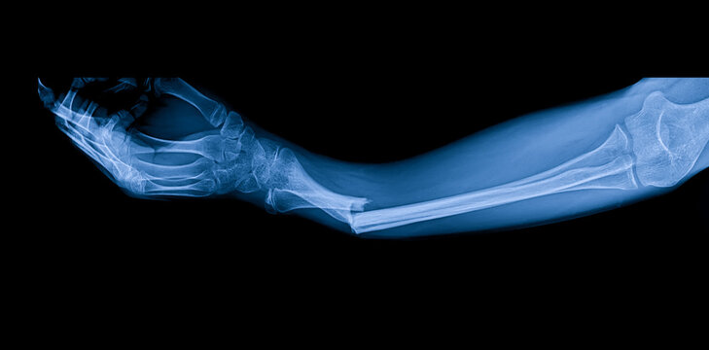
DATASET DESCRIPTION:
The dataset used in this project comprises a diverse collection of bone x-ray images sourced from various medical institutions and databases. It includes images depicting fractures across different anatomical locations and severity levels. The dataset is meticulously curated and annotated, with each image labeled as either "fractured" or "non-fractured" to facilitate supervised learning. Additionally, the dataset is partitioned into training, validation, and test sets to ensure robust model training and evaluation.
Data Partitioning:
To ensure robust model training and evaluation, the dataset is partitioned into three distinct subsets: training, validation, and test sets. The training set comprises the largest portion of the dataset and is used to train the deep learning model. The validation set is employed to fine-tune model hyperparameters and monitor performance during training. Finally, the test set, which is kept separate from the training and validation data, serves as an independent benchmark for evaluating the model's performance prior to deployment in real-world scenarios. This partitioning strategy helps prevent overfitting and ensures that the model's performance generalizes well to unseen data.
Annotation and Labeling:
Each image in the dataset is meticulously annotated and labeled to facilitate supervised learning. An expert radiologist or medical professional carefully reviews and annotates each x-ray image, classifying it as either "fractured" or "non-fractured." This labeling process is essential for training the model to accurately distinguish between normal and fractured bones, laying the foundation for effective fracture detection.
Image Diversity:
The dataset encompasses a wide range of bone x-ray images depicting fractures across different anatomical locations and severity levels. This diversity ensures that the model is exposed to a broad spectrum of fracture patterns, including fractures of the long bones, spine, pelvis, and extremities. By including images from diverse anatomical regions, we aim to train a model that is capable of accurately detecting fractures irrespective of their location.
Dataset Source:
The dataset utilized in this project is sourced from a multitude of medical institutions and databases. These sources contribute a diverse array of bone x-ray images, ensuring representation across various patient populations and clinical settings. By drawing from multiple sources, we aim to create a comprehensive dataset that captures the variability and complexity inherent in real-world fracture cases.

Slide 6
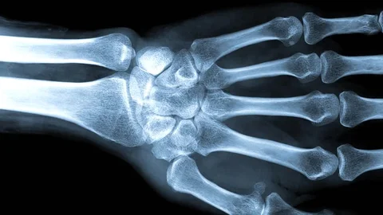

METHODOLOGY
01
02
03
04
Dataset
Description
Data
preprocessing
Implementation of
Models
Model Training and
Evaluation

Slide 7
Module Information
D
CNN
VGG-16
VGG-19
Data
CNN
VGG-16
VGG-19
Data Collection
Data Loading
Data Preprocessing
Data augumentation.
Tailored architecture designed specifically for bone x-ray analysis.
Incorporates multiple convolutional and pooling layers for feature extraction.
Includes fully connected layers for classification, with dropout regularization to prevent overfitting.
Utilizes pre-trained VGG-16 architecture as a feature extractor.
Consists of 16 convolutional layers followed by max pooling and fully connected layers.
Incorporates transfer learning by fine-tuning the pre-trained model for bone x-ray analysis.
Based on the pre-trained VGG-19 architecture, featuring 19 layers.
Leverages deep convolutional networks for feature extraction.
Utilizes transfer learning to adapt the model to bone x-ray analysis, with fine-tuning of parameters.

Slide 8
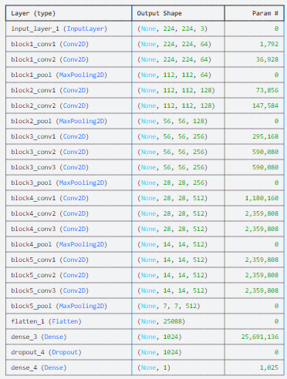
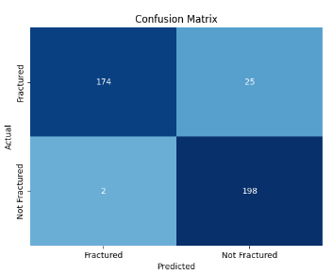
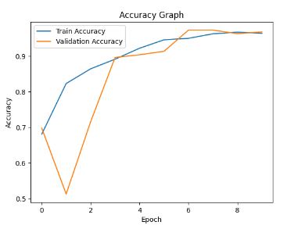
Results of CNN

Slide 9
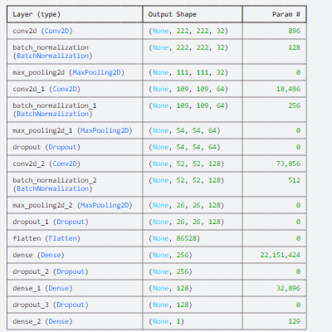
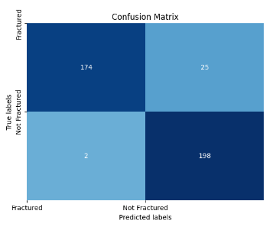
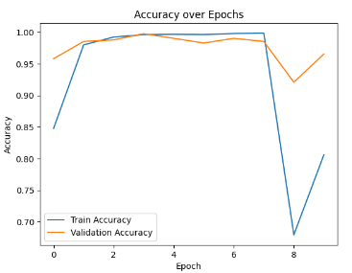
Results of VGG-16

Slide 10
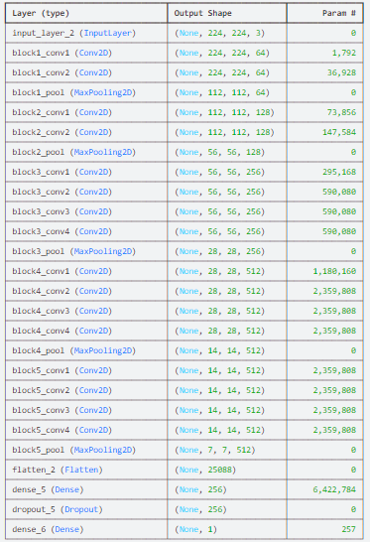
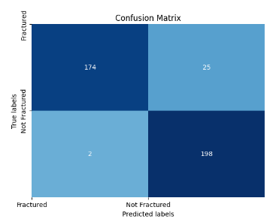
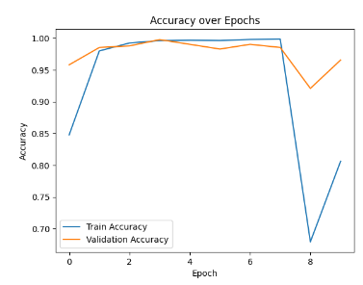
Results of VGG-19

Slide 11

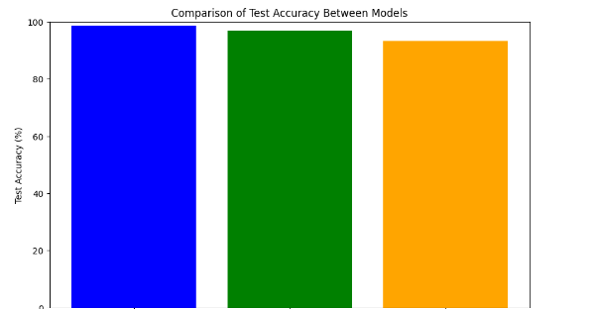
Conclusion and Future
In conclusion, the development of a deep learning model for automated bone x-ray analysis holds immense promise in revolutionizing fracture diagnosis in clinical practice. By harnessing the power of artificial intelligence, we aim to streamline and improve the efficiency of fracture detection processes, ultimately contributing to better patient care and outcomes.
Future research directions in this domain may include:
Fine-tuning the model architecture and hyperparameters to further optimize performance.
Expanding the dataset to encompass a wider variety of fracture types and clinical scenarios for enhanced model generalization.
Conducting prospective clinical studies to validate the model's effectiveness and integration into routine clinical workflows.

Slide 12
Thank you

